Slide 1
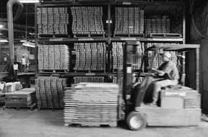

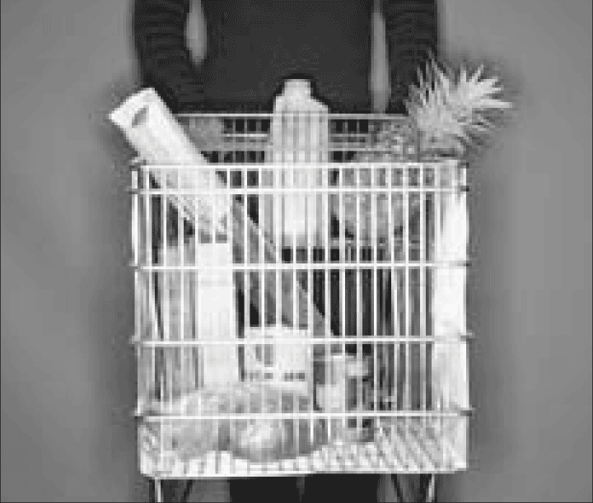


Basic Usage and Architecture

Slide 2
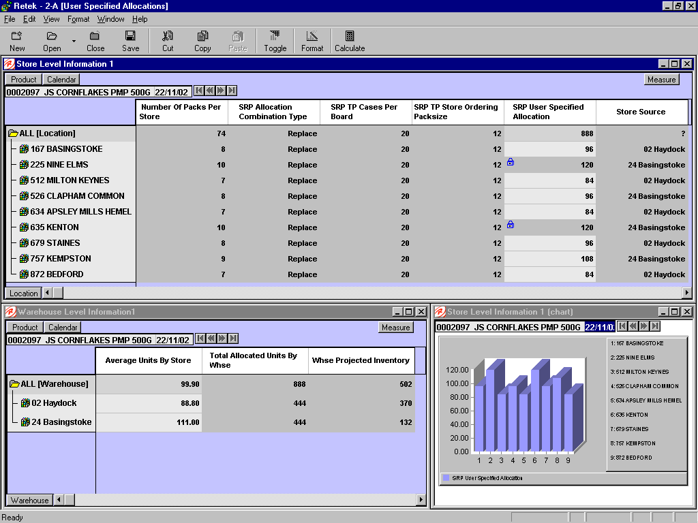
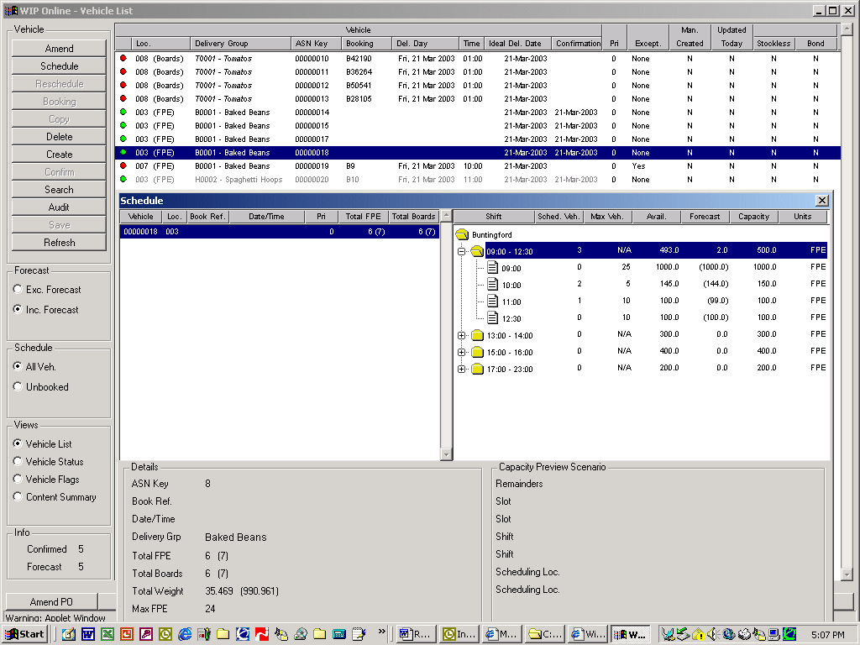
Basic Architecture
Advanced Inventory Planning
Retek Predictive Application Server
WIP / DM Online
SRP Online
WRP Online
WIP Online
DM Online
Java Applications on Oracle DB
SRP Batch
WRP Batch
WIP Batch
DM Batch

Slide 3
Automatic Calculation Architecture
Automatic Routines
Data Preparation
Forecasting
Replenishment
Vehicle building
Static Data
Network Data
Vehicle Data
Schedule Data
RPAS
DM
Master
WIP
Data
Required Foundation Data
Approved Orders / Transfers
Required Sales/Inventory Data
RMS
Retek Merchandising Solution

Slide 4
SRP / WRP User Interaction Architecture
RPAS Master Data
Commit
User A Workbook
Master Data Updated
User B Workbook
What-if Analysis
Save without updating master data
What-if Analysis
Save without updating master data

Slide 5
WIP User Interaction Architecture
Inbound Plan Review
Alter Vehicles
Apply Changes
User B
Inbound Plan Review
Alter Vehicles
Apply Changes
Inbound Plan Review
Alter Vehicles
Apply Changes
User A
User C
WIP

Slide 6
DM User Interaction Architecture
Review Profiles
Delete Profile
Apply Changes
User B
Alter Receiving Calendar
Apply Changes
Create Order Cycle
Apply Changes
User A
User C
DM

Slide 7
Key Elements
During batch run store and DC/CDC plans are reconciled as part of process
Each level of supply chain is reconciled to the next as appropriate for the network flow configuration defined in Data Management
Essentially overnight process will be a stream of batch jobs:
  Data Management
  SRP Batch
  WRP Batch
  WIP Batch

Slide 8
High Level Data Flows – with RMS
Retek Predictive Application Server
RDF
Forecast
SRP/
USA
WRP/
WIP(batch)
Recommended
Purchase Orders
Sales
Recommended
Transfers
Foundation data
Product
Organisation
Time
Inventory
Levels
Orders
WIP (online)
Recommended
Purchase Orders
RMS
Transfers
Receiving
Schedule
WMS
EPOS
Receipts

Slide 9
AIP Maintenance and Operation

Slide 10
Data Management
Data Management (AIP)
Define Network
Manage
Supplier Splits
Manage Static Data
AIP Data Management includes the handling of static and dynamic data to support the other AIP process areas:
  Define Network – The physical network must be defined to enable AIP to understand the network flow an item will have/has. This area encompasses the switching of stores and items within the physical network, potentially for short periods of time to resolve capacity issues or operational constraints
  Manage Supplier Splits – For multi sourced items supplier split data is required to be maintained
  Manage Static Data – All static data required by AIP which is not interfaced from an external system must be created and managed in AIP (e.g. order calendars, lead times)

Slide 11

Data Management
To provide functionality to maintain supply points for store orders from warehouses and suppliers, together with the appropriate order cycles
To provide functionality to maintain supplier ordering parameters for Supplier to warehouse deliveries together with appropriate order and delivery cycles
To provide functionality to maintain supplier ordering parameters for 2nd stage ordering for supplier to PCC/BOND deliveries
To provide the functionality to maintain shared data elements across WRP and SRP e.g. pack sizes by warehouse
To provide the functionality to introduce new and discontinue existing commodities/stores and warehouses into and out of the supply chain for SRP, WRP and WIP purposes

Slide 12

Data Management
Balance the network through enabling the switching of commodities from one source to another while respecting network constraints on a temporary or permanent basis
Manage Supplier Splits
Manage Static Data
  Store and Warehouse Order Calendars
  Order Groups
  Delivery Groups
  Pack size information
Alerts can be defined for DM to identify incorrect or missing data assignments

Slide 13







Data Management
Use of ‘Profiles’
The system will offer two types of profile:
  Direct to Store
  Warehouse Profiles
Profiles are used to minimise the potentially high number of supply points in a medium to large supply chain. For example imagine potential number of supply point assignments for 50,000 items across 500 stores, 10 DCs, 2 CDCs and 2000 Suppliers.
Profiles provide support for grouping like supply or stock items (for example a group of items all of which are stocked for a store in the same DC) and defining how they will flow through the system
STORE
SUPPLIER
STORE
REGIONAL DC
STORE
NATIONAL DC
SUPPLIER
CONSUMER
REGIONAL DC
CATALOG
NATIONAL DC
SUPPLIER
REGIONAL DC
WEB
IMPORT

Slide 14
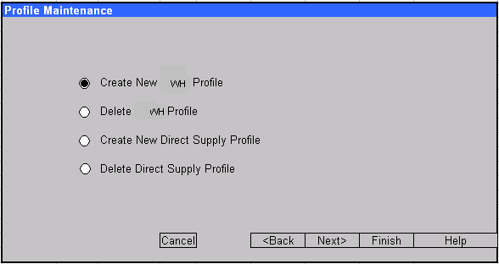
Data Management
Use of ‘Profiles’
Profiles can be maintained in DM in the following ways:
  New profiles created (can be modeled on existing profile)
  Profiles Deleted
This functionality will be offered for both types of profile

Slide 15
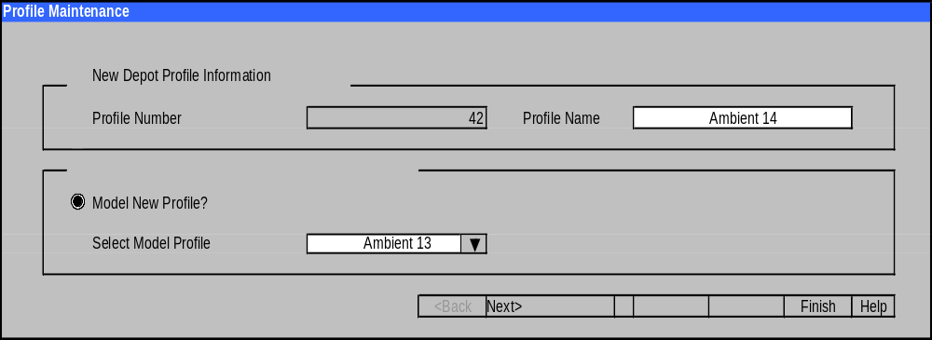
Data Management
Use of ‘Profiles’
Profiles can be maintained in DM in the following ways:
  New profiles created (can be modeled on existing profile)
  Profiles Deleted
This functionality will be offered for both types of profile

Slide 16
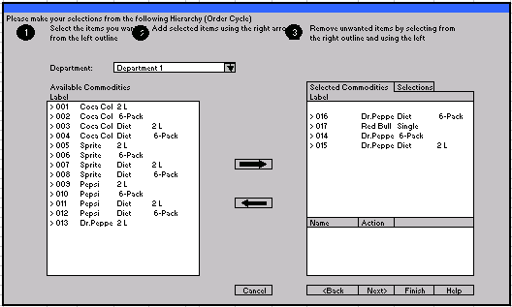
Data Management
Use of ‘Profiles’
Items will ideally be assigned to profiles automatically using a batch process when they are added to item master and then uploaded to AIP
Where this is not possible, or to override this, it will be possible to manually assign items to profiles

Slide 17
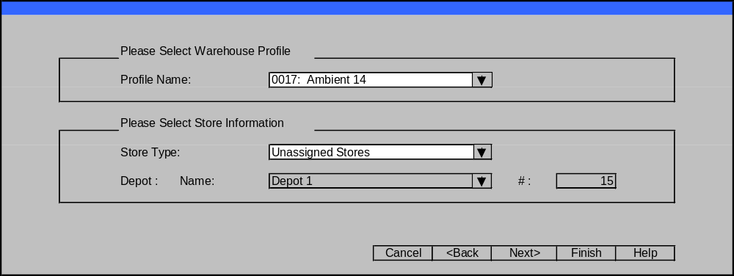
Data Management
Use of ‘Profiles’
Profiles will therefore dictate, for the items in the profile, which stores will receive that item from which warehouses or which direct suppliers they will receive that item from.

Slide 18
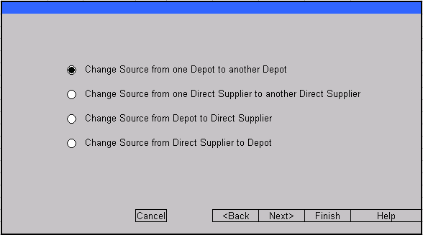
Data Management
Use of ‘Profiles’
It will be possible to quickly change supply chain assignments to respond to permanent or temporary changes in the network.
WH
WH
WH
WH

Slide 19
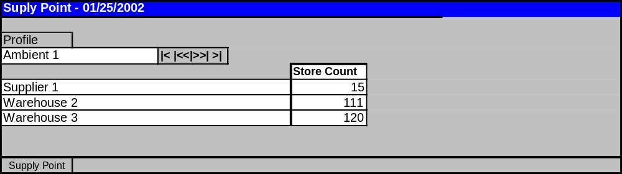
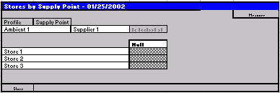
Data Management
Use of ‘Profiles’
Profiles will also bring together supply points, order cycles and calendars.
Each night batch routines will update and configure data held in DM for use in SRP/WRP in that nights batch run. For example changes of DC source for an item for a store, changes to item pack size, etc.

Slide 20
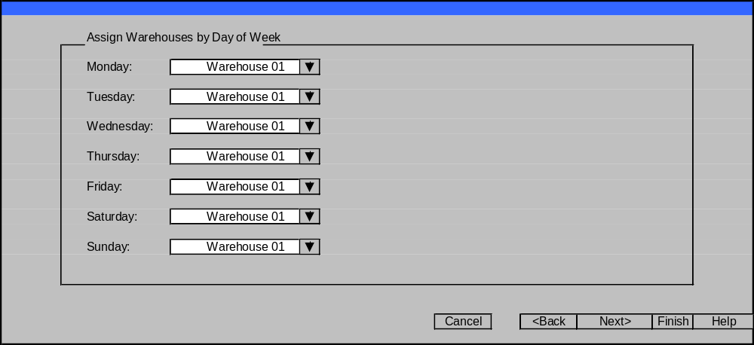
Data Management
Use of ‘Profiles’
Profiles will also bring together deliver points, order cycles and calendars.
Each night batch routines will update and configure data held in DM for use in SRP/WRP in that nights batch run. For example changes of DC source for an item for a store, changes to item pack size, etc.

Slide 21
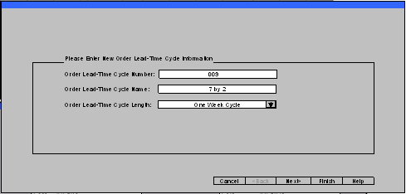
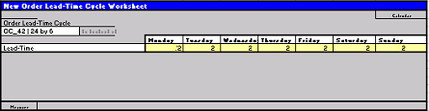
Data Management
Static Data
Can be imported from external systems or directly maintained in AIP. Design goal is to enable AIP to essentially operate ‘stand alone’ with regard to this static data if it does not exist elsewhere.

Slide 22
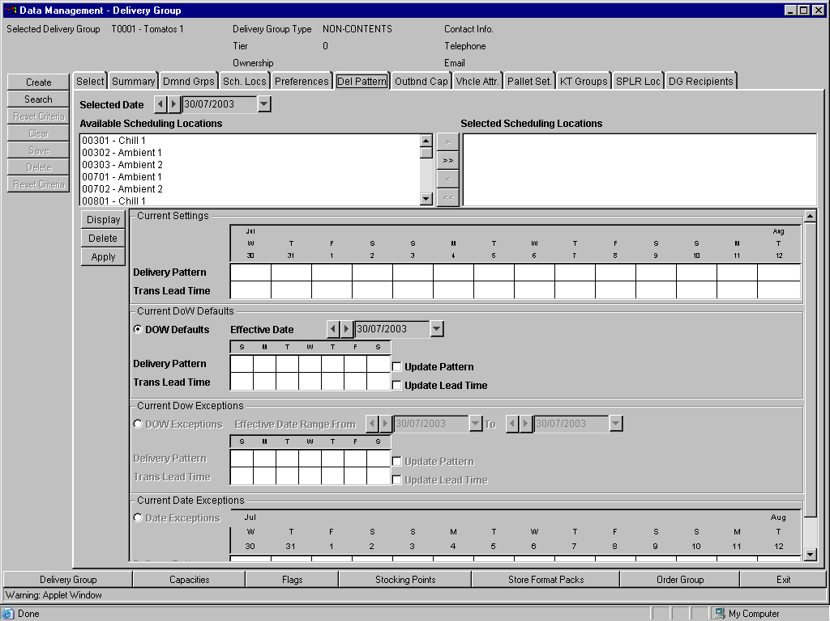

Slide 23
